Slide 1
Lecture # 03 Demand & Supply

Slide 2
Demand
A desire to process a good supported by Willingness and Ability to pay
Willingness but not the ability to pay is wish
Three main characters of demand are:
Willingness and ability to pay
Demand is always at a price
Demand is always per unit time

Slide 3
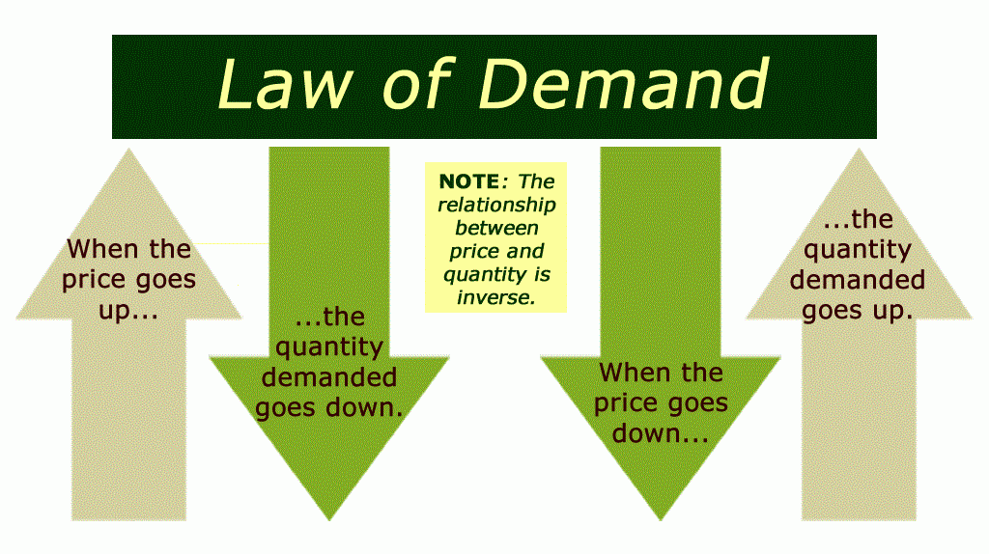
Experience of Consumer

Slide 4
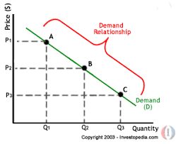
Graphical Representation of Law of Demand

Slide 5
Reasons for Above Behavior
Increase in the no. of consumer
Impact on purchasing power.
Substitute effect

Slide 6
Assumption of law
Units should be of same nature.
Taste of consumer should not be change.
Income of consumer should not change.
Price of substitute should remain constant.
No new substitute of commodity discovered.
Population should not changed.
No possibility in the change of the value of currency.
The use of commodity should not be a cause of distinction.

Slide 7
Exception of Law
Distinctive goods.
Rare Commodities
Basic necessities of life.
Ignorance of people.
Festivals

Slide 8
Supply
Supply is the amount of commodity that sellers are able to and willing to offer for sale at different prices per unit of time.
Distinction between Stock and Supply.

Slide 9
Law of Supply
Shows interrelationship between price and supply.
“if all other things remains constant, the quantity supplied of a commodity increases in its price and vice –versa.
What are all other things?

Slide 10
The Law of Supply
There is a direct relationship between price and quantity supplied.
Quantity supplied rises as price rises , other things constant.
Quantity supplied falls as price falls, other things constant.
As the price of a product rises, produces will be willing to supply more.

Slide 11
The Supply Curve
The supply curve is the graphic representation of the law of supply.
The supply curve slopes upward to the right.
The slope tells us that the quantity supplies varies directly – in the same direction- with the price.

Slide 12
A Sample Supply Curve

Slide 13
Supply Curve DVDs

Slide 14
Slope of Supply Curve
Supply Curve has a positive slope.
The law of supply is accounted for by two factors:
Assuming firms costs are constant, a higher price means higher profits.
When prices rise, firms offers more quantity in market to be sold, because a decrease in price in future reduce their profit.

Slide 15
Assumptions of Law of Supply and Demand
Resource Price
Expectation of Producers
Number of Producers
Prices of related goods and services
Technology and productivity
Supply

Slide 16
Exceptions of Law and Supply and Demand
Transfer from one place to another.
Need of cash
Defect in means of transport
Political instability
Improper behavior in agricultural and industrial labor

Slide 17
Shifts in Supply Versus Movement Along a Supply Curve
Supply refers to a schedule of quantities a seller is willing to sell per unit of time at various prices , other things constant.
Quantity Supplied refers to a specific amount that will be supplied at specific price.
Changes in price causes changes in quantity supply represented by a movement along a supply curve.

Slide 18
Shift in Supply versus Movements Along a Supply Curve
A movement along a supply curve –the graphic representation of the effect of a change in price on the quantity supplied
If the amount supplied is affected by anything other than a change in price , there will be shift I supply.

Slide 19
Shift in Supply Versus Movements Along a Supply Curve
Shift in Supply -the graphic representation of the effect of a change in a factor other than price on supply.

Slide 20
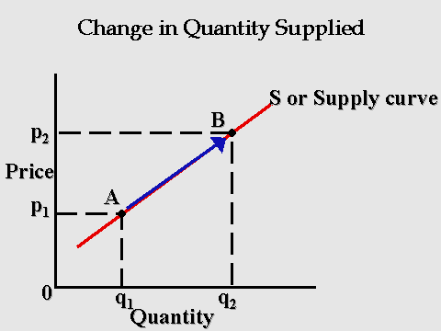

Slide 21
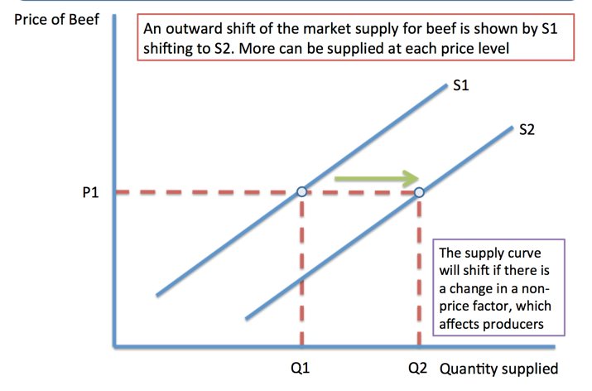

Slide 22
Shift Factors of Supply
Other factors besides price affect how much will be supplied
Prices of inputs used in the production of a good
Technology
Suppliers expectation
Taxes and subsidies
Modern means of transportation
Change in weather
Cartel

